Slide 1
TDK Turkish Dictionary
Emrah Özcan

Slide 2
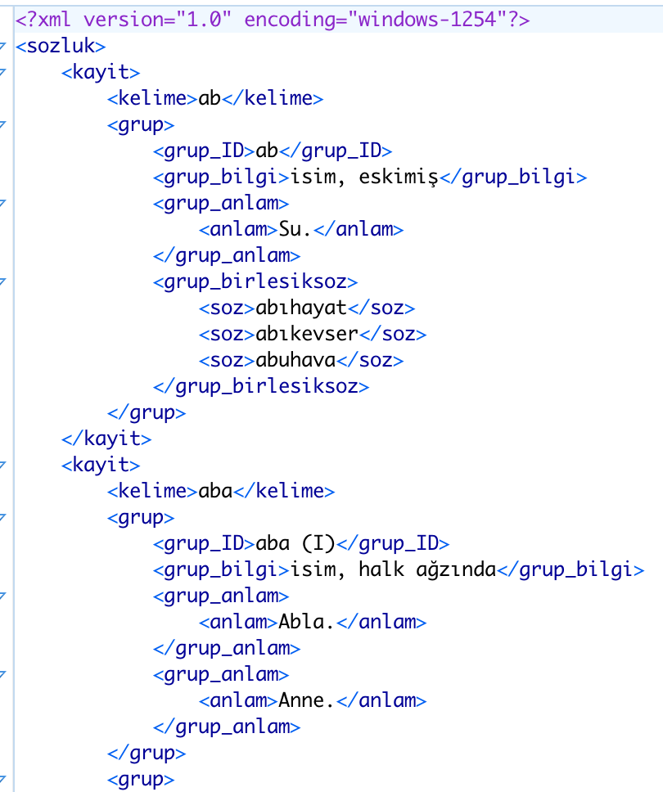
My original XML file in non-TEI

Slide 3
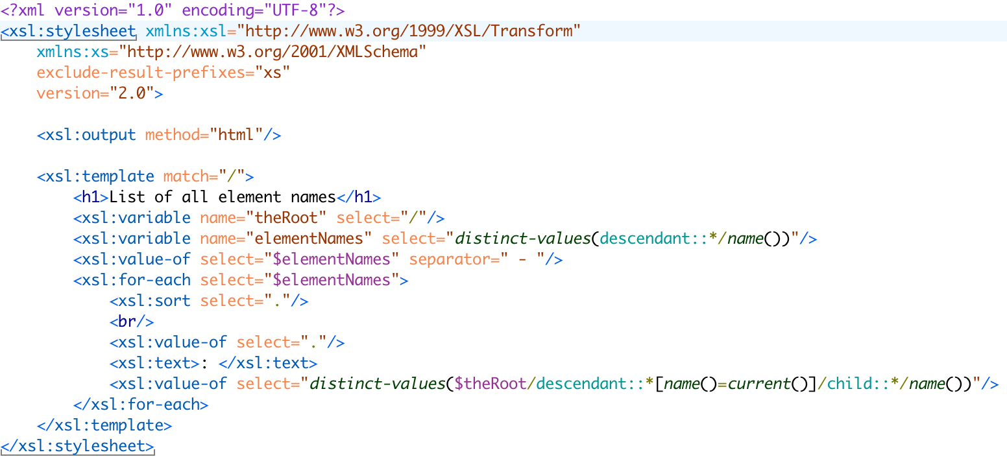
Finding out the elements

Slide 4
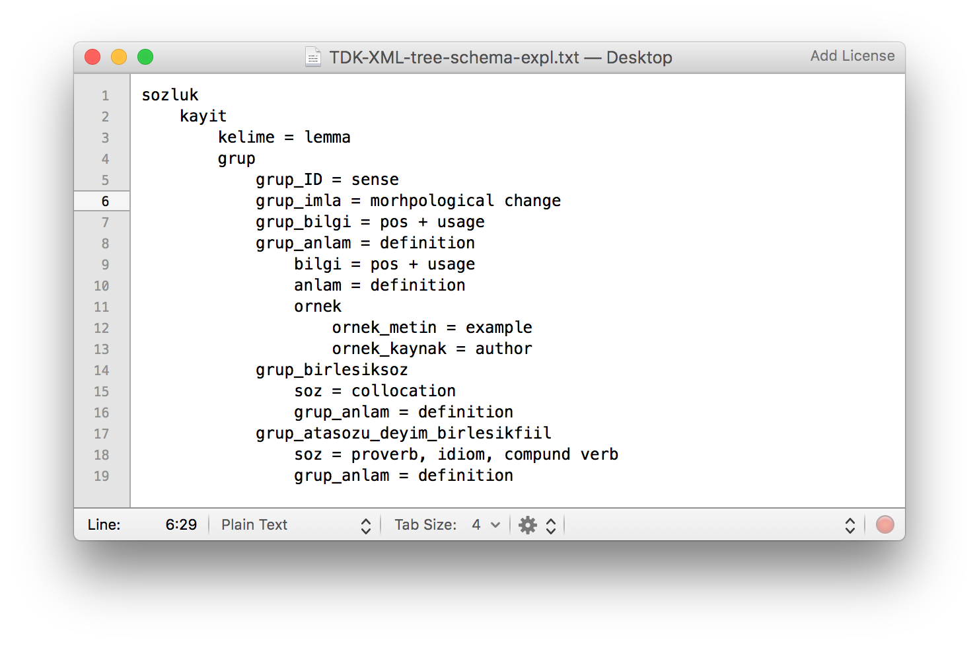
The elements of my original file

Slide 5
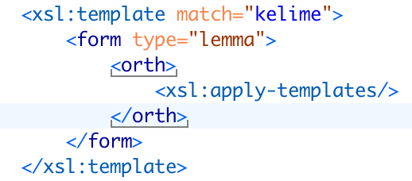
XSLT transformation – Let the magic happen!

Slide 6
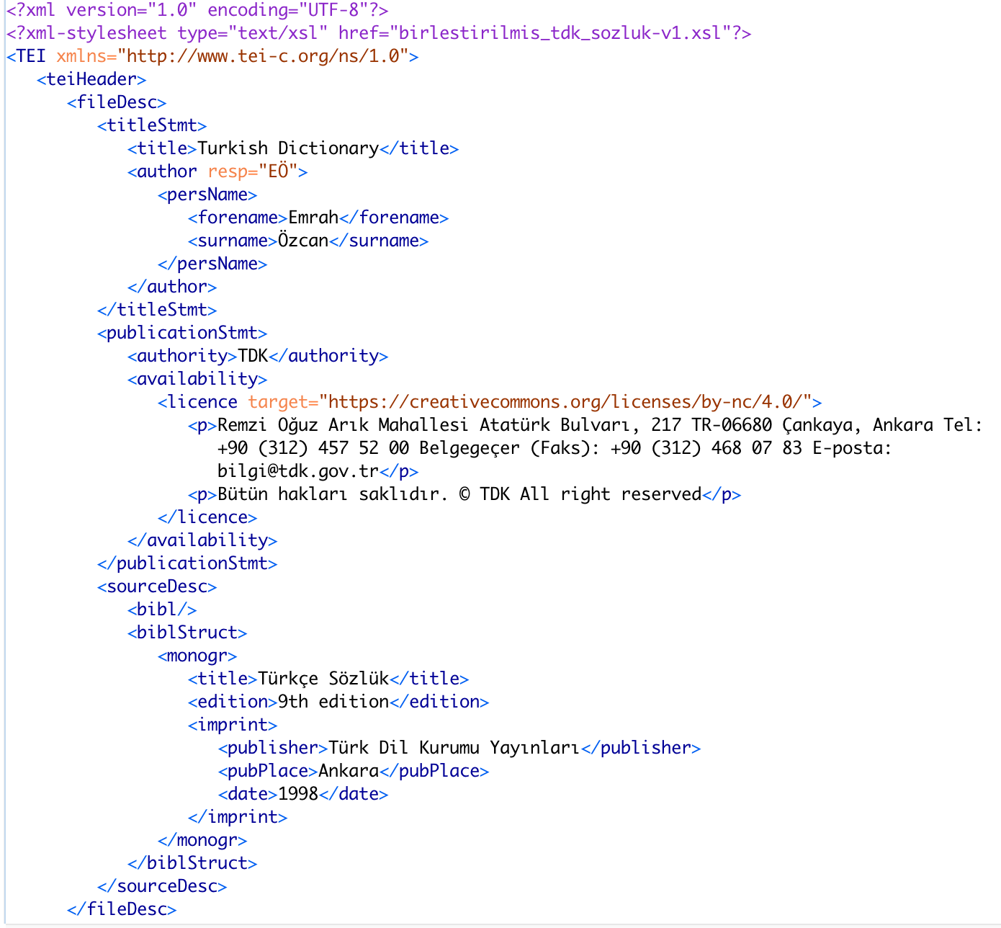
TEI Header

Slide 7


Slide 8
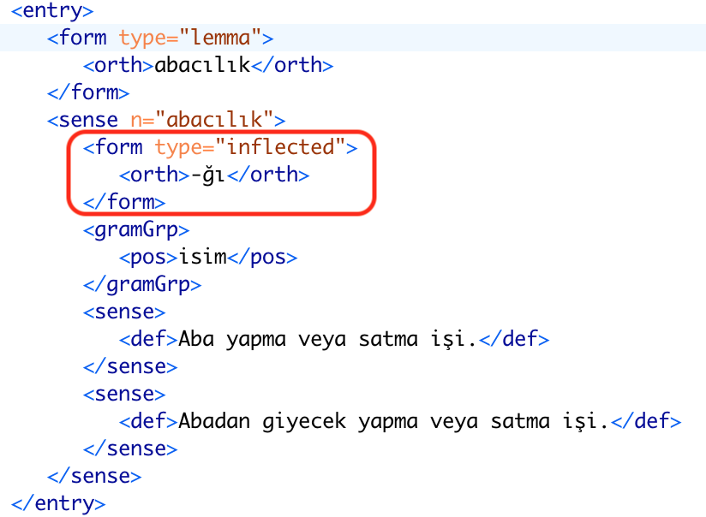

Slide 9
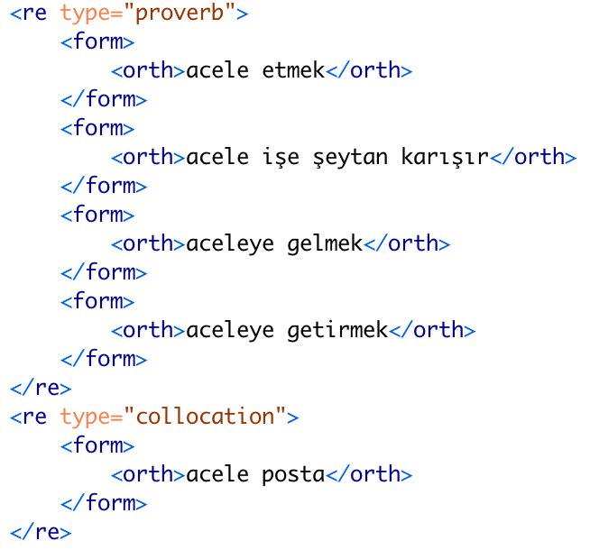

Slide 10
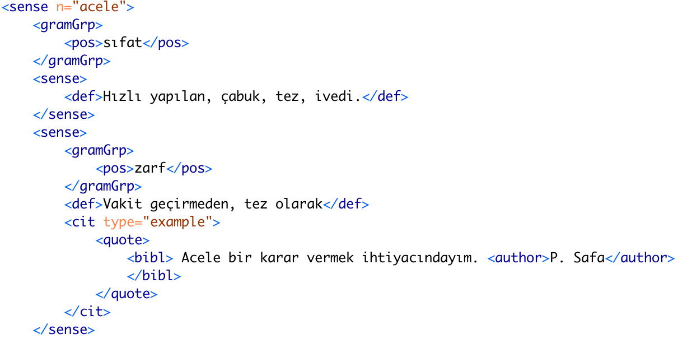

Slide 11
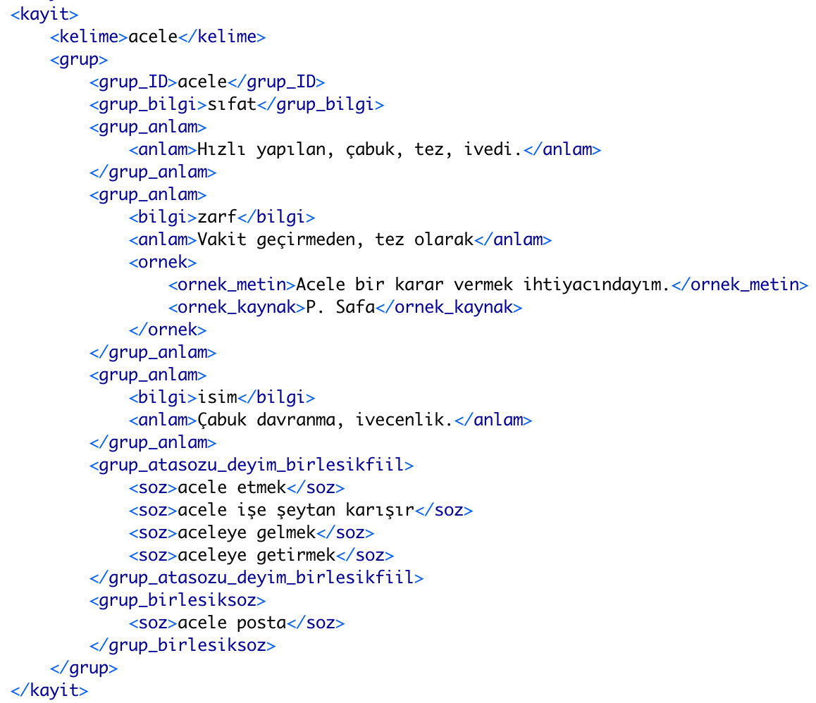
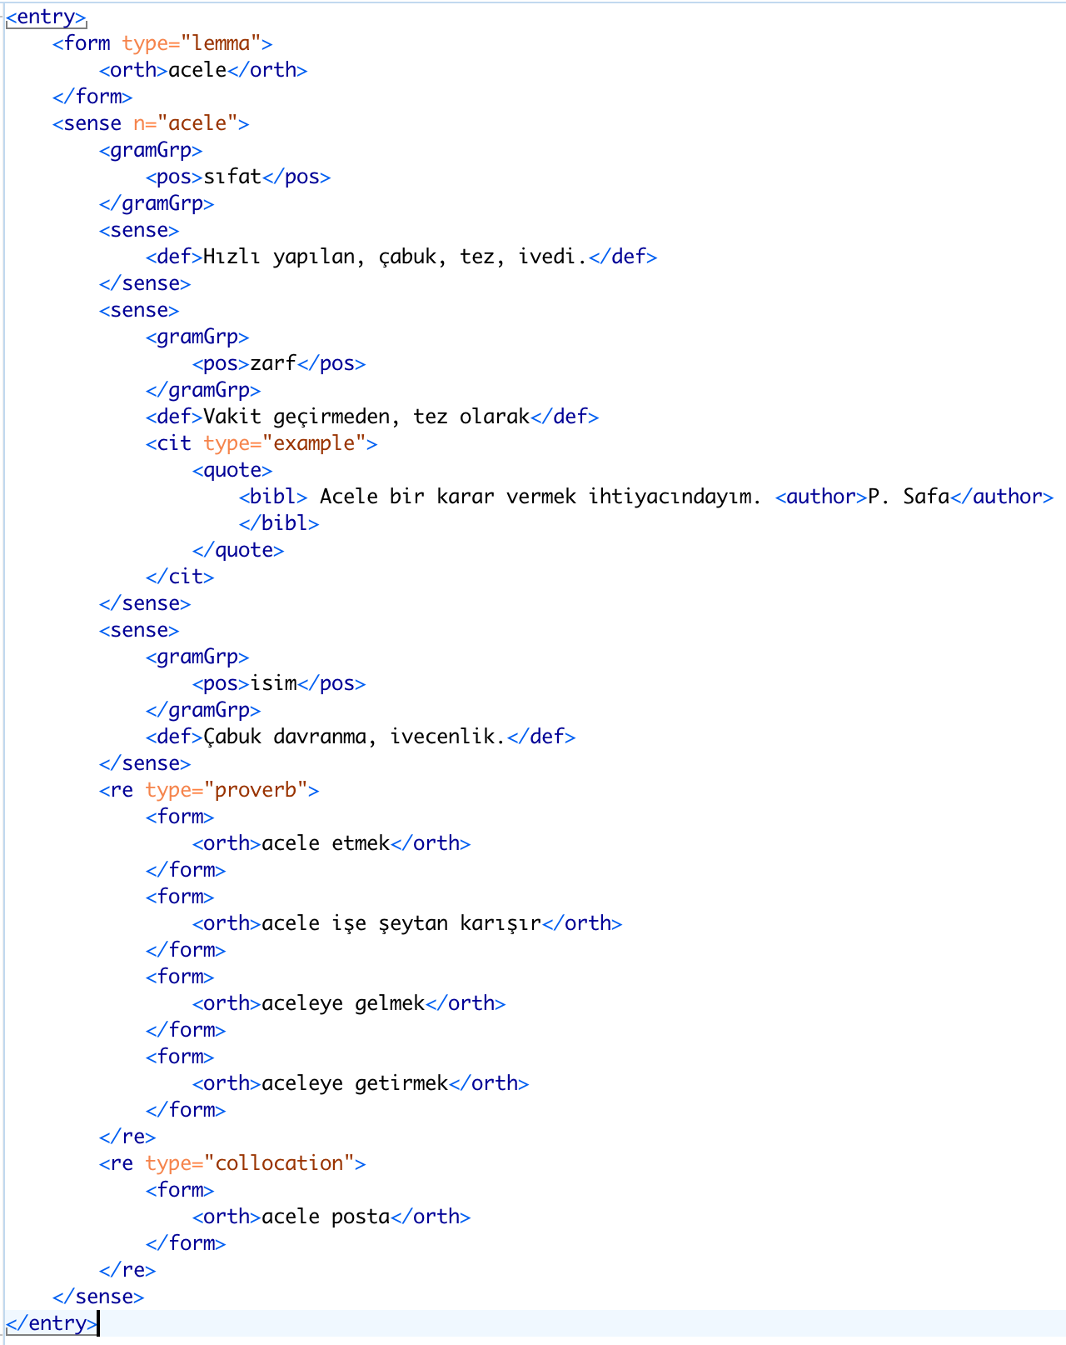



Slide 12
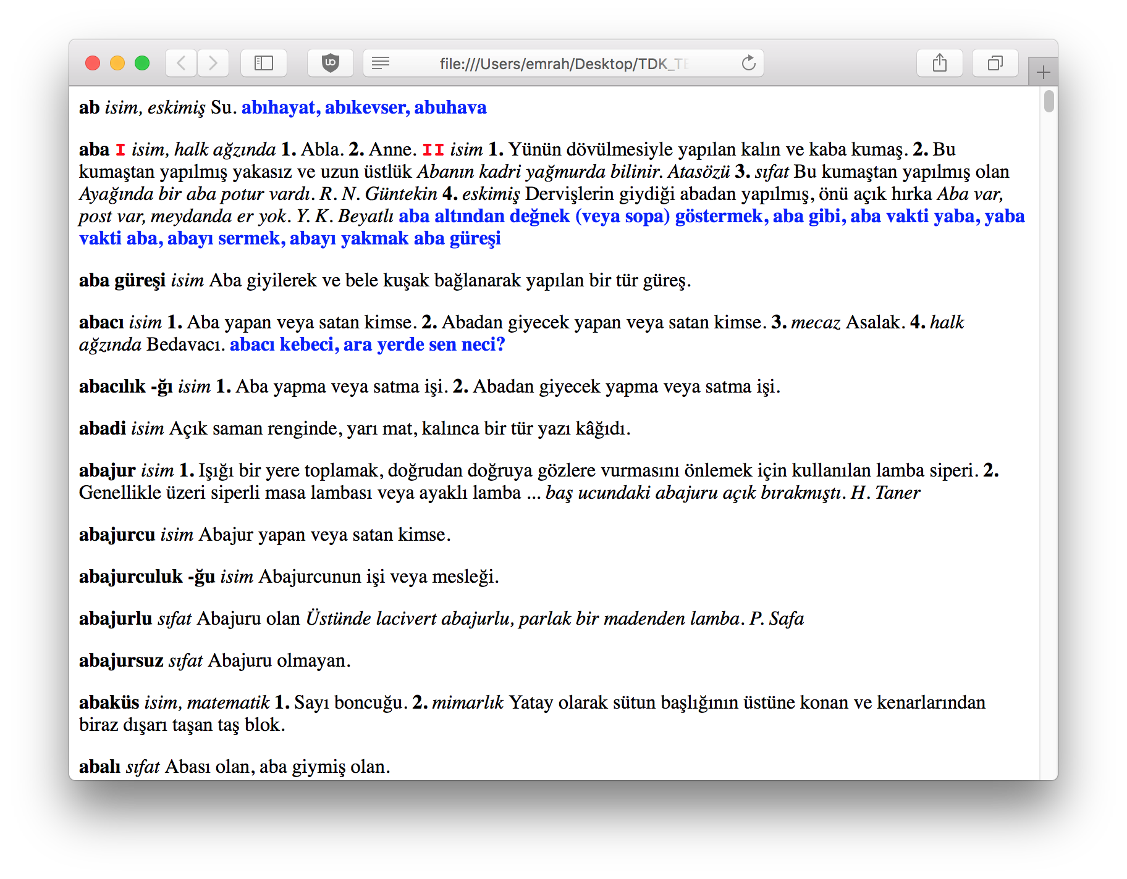
And finally…

Slide 13

Thank you everyone!
Emrah Özcan

